Slide 1
Friday Challenge #001

Slide 2
The task
You are given a stream of numbers (IEnumerable<double>).
The goal is to output a stream of medians (IEnumerable<double>).

Slide 3
Median – the definition
Median is a number in the middle of the sorted population.
For an array {1, 2, 3}, median is 2.
For an array {1, 2, 3, 4} median is (2+3)/2.0 = 2.5.

Slide 4
Straightforward implementation
Keep sorted list of numbers (an invariant).
Find a value in the middle (either at N/2 or average of N/2 ceiling and floor).
Rely on iterator block to produce output stream.
Notes:
Show actual demo - MedianSelectorQuickSort

Slide 5
Straightforward implementation - notes
Time complexity: O(N*N*lnN) (due to sorting of the list for each new number)
Space complexity: O(N)
Can we do better?

Slide 6
Insertion sort implementation
Keep sorted list of numbers (an invariant). No need to sort all values each time, just find the correct place to insert.
Find a value in the middle (either at N/2 or average of N/2 ceiling and floor).
Rely on iterator block to produce output stream.
Notes:
Show actual demo - MedianSelectorInsertionSort

Slide 7
Insertion sort implementation- notes
Time complexity: O(N*N) (due to linear insertion time of each new number)
Space complexity: O(N)
Can we do better?

Slide 8
PriorityQueue (heap) implementation
Keep descending left queue and ascending right queue.
Keep them balanced (an invariant) – max item below the middle is in left queue min item above the middle is in the right queue.
Find a value in the middle (either the bigger queue top or an average of both queues tops).
Rely on iterator block to produce output stream.
Notes:
Show actual demo - MedianSelectorPriorityQueue

Slide 9
PriorityQueue (heap) implementation - notes
Time complexity: O(N*lnN) (due to logarithmic insertion/extraction time of each new number)
Space complexity: O(N)
Is possible out of the box since .NET 6.
Can we do better? (if input values are unique, there is no need to keep them all in the queues)

Slide 10
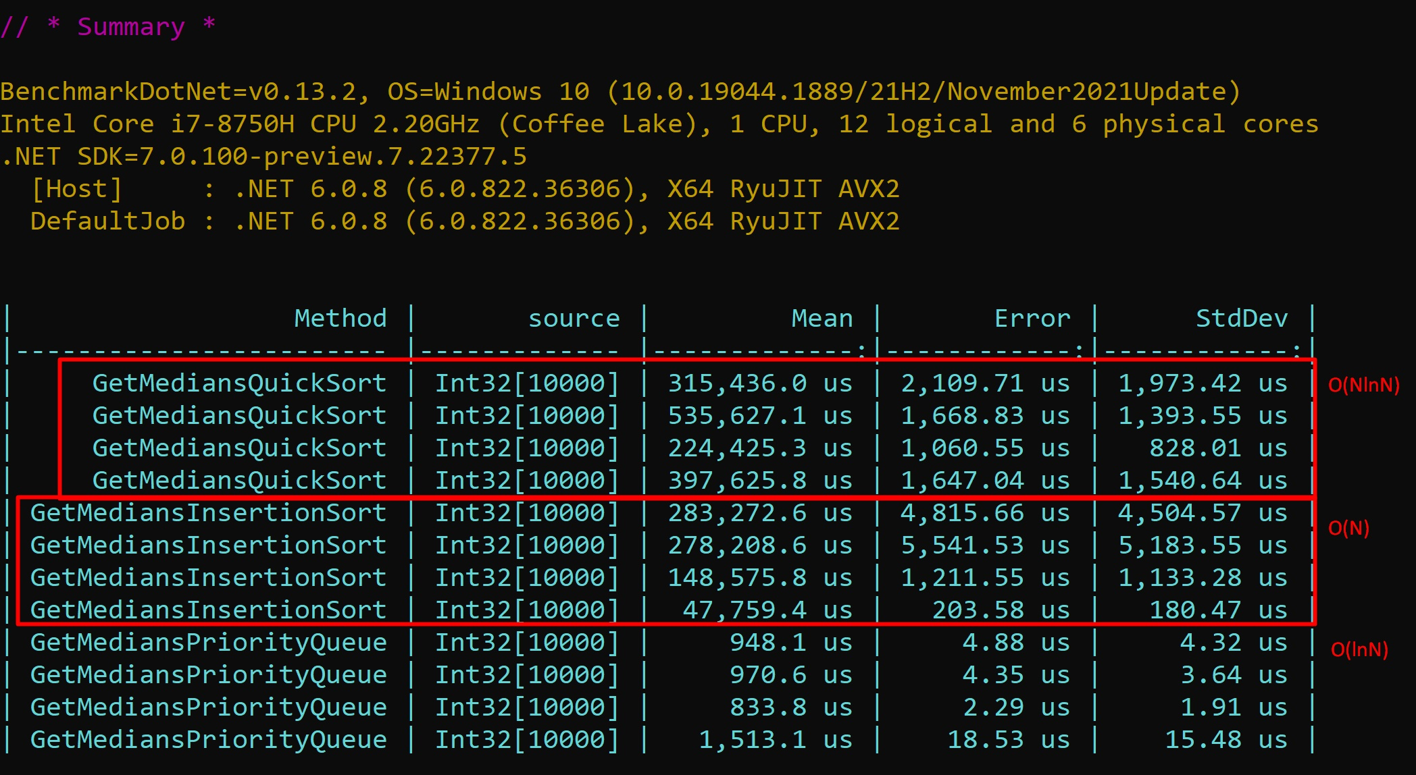
Benchmark (complexity per step)

Slide 11
The winner
Egemen Ciftci (the first and the best solution!)

Slide 12
Thanks for your attention!

Slide 13
Useful links
Introduction to Algorithms
Coursera course on algorithms.
Is possible out of the box since .NET 6.
Can we do better? (if input values are unique, there is no need to keep them all in the queues)

